Slide 1
“Coraline” by Neil Gaiman
Chapter 2

Slide 2
Find as many as possible words connected with “Clothes”

Slide 3
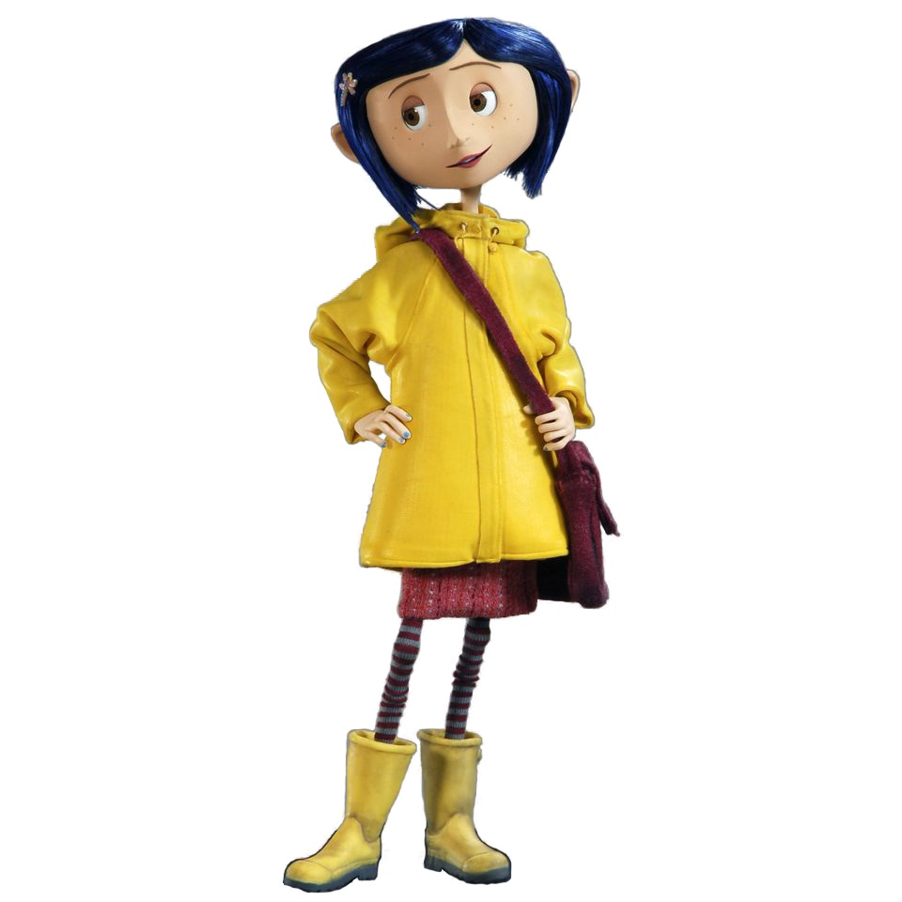
a coat,
a scarf,
Wellington boots,
a pullover,
a cardigan,
glasses,
school clothes,
a hood

Slide 4
Find as many as possible words connected with “House”

Slide 5
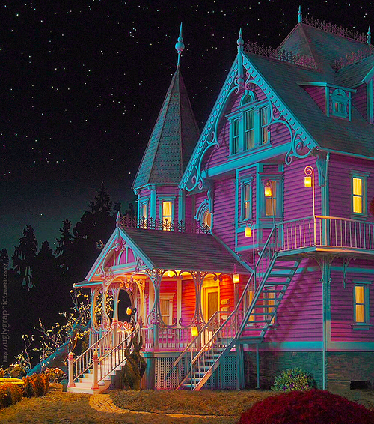
a dressing room,
upstairs,
stairs,
an attic,
a study,
a corner,
furniture,
a parlour,
a black-and-white photograph,
a frame,
a china cup,
a saucer,
a hall,
an armchair,
a fireplace,
a mantelpiece,
a jar

Slide 6
Match the definitions with the words and find examples in the text
look around
peer
stare
to look at something very carefully and for a long time, especially because you cannot see it well
you walk round it and look at the different parts of it
to look at someone or something for a long time without moving your eyes

Slide 7
Find two more comparisons in the text
For example:
They were having an argument as old and comfortable as an armchair.

Slide 8
Complete the phrase and say how it refers to the text
_______ (v) lost
_______ (v) a flat with sb.
_______ (v) smth. wrong
_______ (v) of flowers
on the computer ____ (n)
a sheet of ______ (n)
_____ (v) an argument
______ (v) exciting
______ (v) like

Slide 9
Find the synonyms for
appear = ?
You appear to be very nervous.
a very quiet voice = ?
happy = ?
disturb, trouble = ?

